Slide 1
Mumbai Rainfall Forecasting
Machine Learning for Water Resource Planning
121 Years of Data
1901 – 2021
Random Forest Model
2022 Forecast

Slide 2
Introduction
Rainfall forecasting plays a critical role in water resource planning, reservoir management, and efficient water allocation.
Mumbai experiences highly seasonal rainfall, with the majority occurring during the monsoon months (June–September).
Accurate rainfall prediction is essential to ensure a reliable water supply for residents and industries.
This project uses 121 years of historical monthly rainfall data (1901–2021) for analysis and forecasting.
Multiple forecasting approaches were explored to develop an effective machine learning-based rainfall prediction model.

Slide 3
Problem Statement
Mumbai’s water management operations depend heavily on accurate rainfall forecasting for effective planning and decision-making.
Uncertain rainfall patterns make it difficult to optimize water allocation, reservoir storage, and distribution strategies.
Below-average rainfall can lead to water shortages, while inaccurate planning may increase operational inefficiencies and costs.
Limited forecasting capability reduces preparedness for drought conditions and affects infrastructure maintenance scheduling.
Therefore, there is a need for a reliable data-driven rainfall forecasting model to predict future rainfall patterns and support efficient water resource management.

Slide 4
PROJECT OVERVIEW
Build a rainfall forecasting model using historical rainfall data from Mumbai.
Predict future monthly rainfall patterns to improve planning and preparedness.
Help authorities make better decisions for water storage, distribution, and conservation.
Enable proactive drought preparedness and water conservation planning.
Assist in scheduling infrastructure maintenance during low-rainfall periods.

Slide 5
DATASET OVERVIEW
121 Years of Mumbai Rainfall Data (1901–2021)
121
Years of Data
1,452
Monthly Records
2,168 mm
Mean Annual Rainfall
~85%
Monsoon Contribution
(Jun–Sep)
Key Statistics
Attribute | Value
Wettest Year | 2020 (3,563 mm)
Driest Year | 1941 (1,059 mm)
Missing Values | None
Long-term Trend | +4.78 mm/year
Data Format | Monthly totals (mm)
Monsoon Seasonality
June–September contributes roughly 85% of all annual rainfall. This extreme concentration makes monsoon prediction the single most critical factor for water planning.

Slide 6
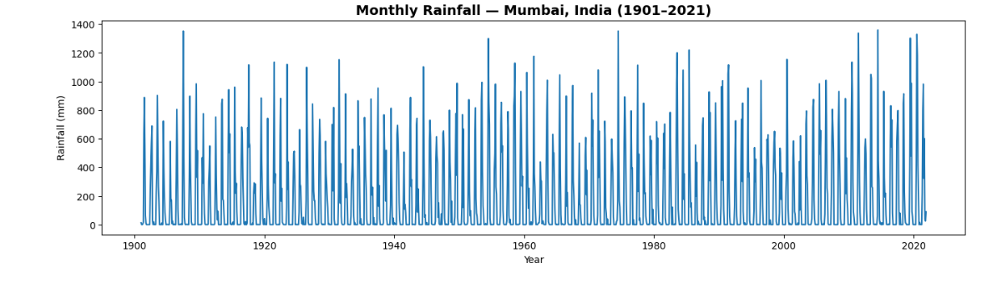
EXPLORATORY DATA ANALYSIS
Historical Monthly Rainfall Trends in Mumbai (1901–2021)
KEY OBSERVATIONS
A clear repeating seasonal rainfall pattern is observed across the years.
Rainfall remains close to near-zero during most non-monsoon months.
Some years show extreme rainfall peaks, indicating unusually high rainfall events.
Rainfall is heavily concentrated during the monsoon months (June–September) each year.
Despite fluctuations, the overall seasonal rainfall cycle remains consistent over time.

Slide 7
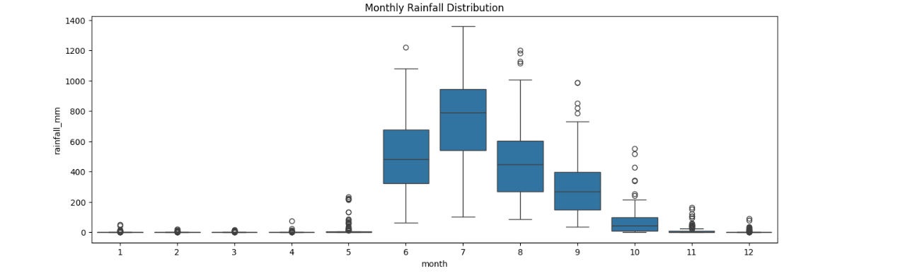
Peak Rainfall Occurs During the Monsoon Season
June – September 4-month monsoon window driving the strongest rainfall patterns in Mumbai.
Key Observations
Rainfall is strongly concentrated during the June–September monsoon season.
July shows the highest rainfall intensity, followed by August.
Non-monsoon months receive minimal rainfall in comparison.
This consistent seasonality makes historical rainfall highly useful for forecasting future patterns.

Slide 8
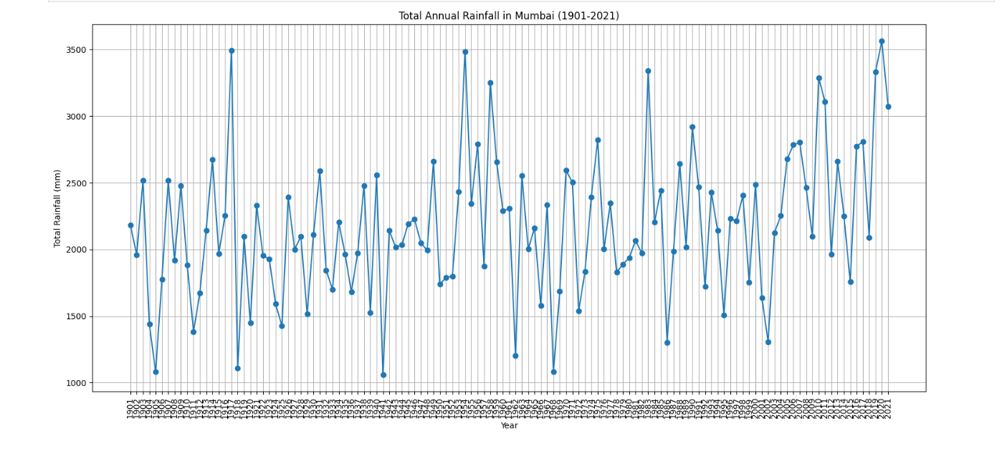
Annual Rainfall Variability in Mumbai (1901–2021)
Key Observations
Annual rainfall varies significantly from year to year.
Some years experienced very high rainfall, while others recorded much lower totals.
A gradual increase in annual rainfall can be observed over the long term.
Recent years show more frequent high-rainfall events compared to earlier decades.
These fluctuations highlight the need for accurate rainfall forecasting for better planning.

Slide 9
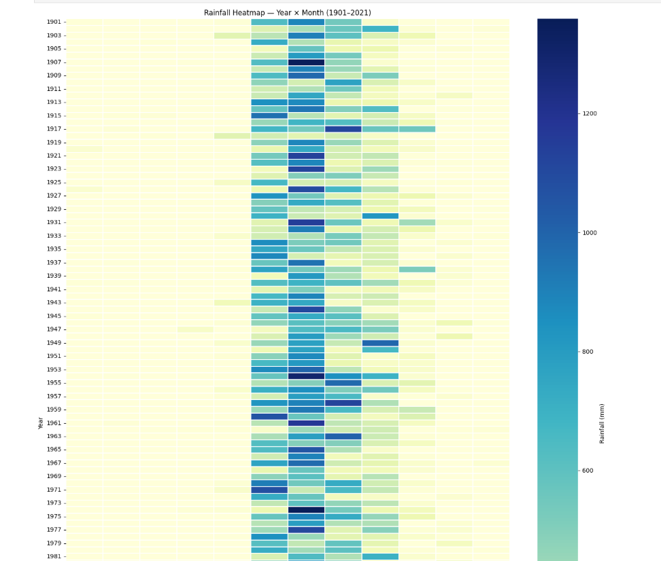
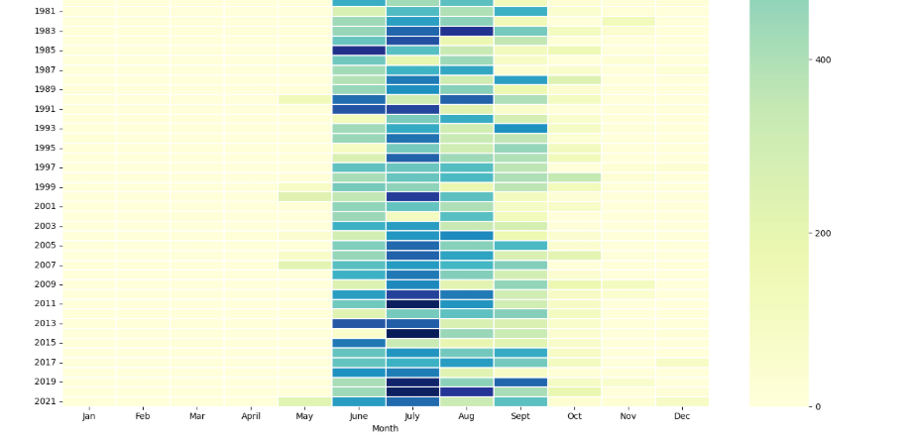
Key observations
Rainfall is clearly concentrated in a few specific months each year.
The heaviest rainfall consistently occurs during the mid-monsoon period.
Some years experienced much stronger rainfall than others, visible through darker intensity bands.
Most months outside the monsoon season receive very little rainfall.
A consistent seasonal rainfall pattern is visible across the entire historical period.

Slide 10
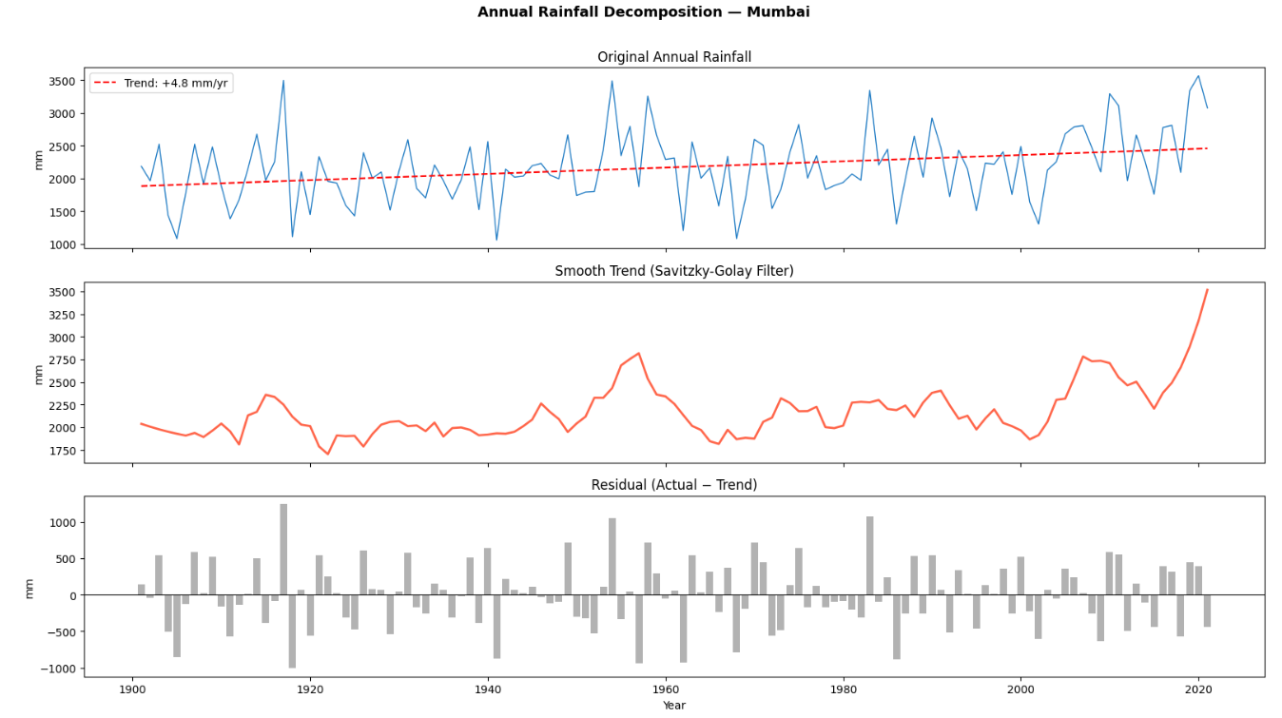

Slide 11
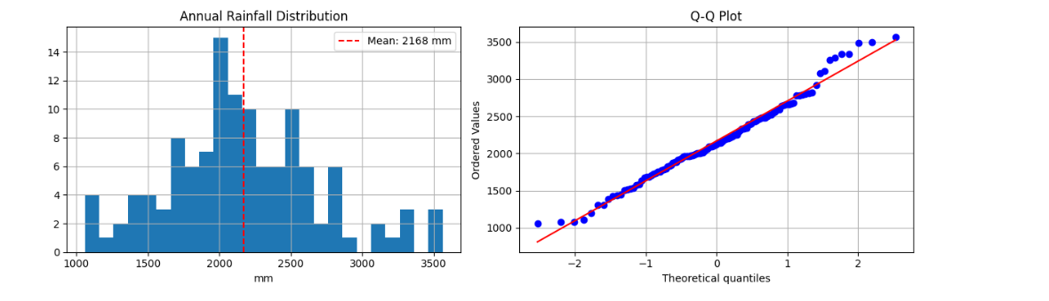
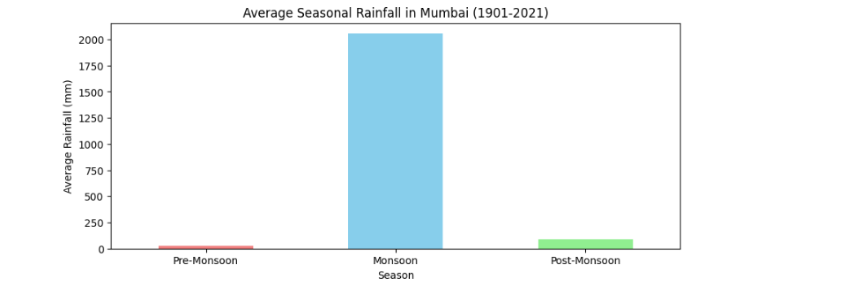
Rainfall Distribution & Seasonal Analysis
Annual rainfall is centered around an average of approximately 2168 mm, with noticeable variation across years.
Most rainfall values follow a fairly consistent distribution, though a few years show unusually high rainfall.
The Q-Q plot suggests the data is approximately normally distributed, with slight deviations at extreme values.
Seasonal analysis shows that the monsoon season contributes the overwhelming majority of annual rainfall.
Pre-monsoon and post-monsoon periods contribute only a small portion of the total yearly rainfall.

Slide 12
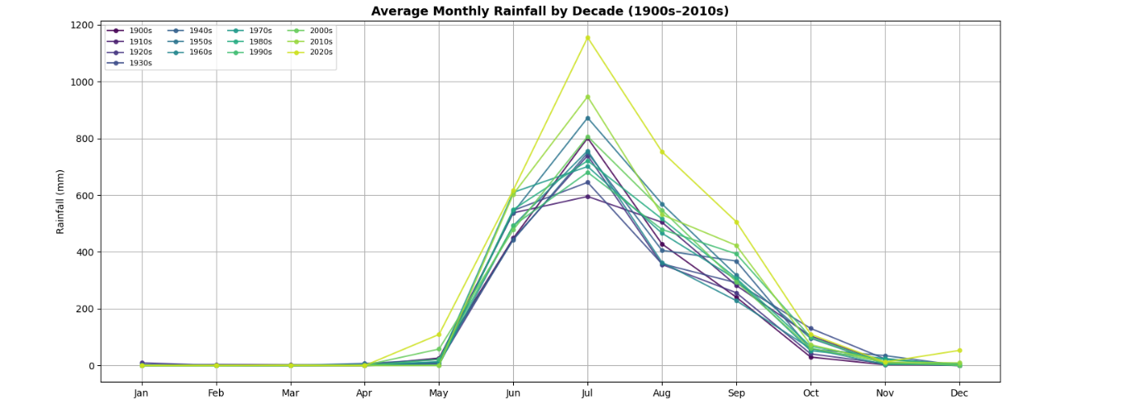
Decadal Rainfall Pattern Comparison
The overall seasonal rainfall pattern remains consistent across all decades.
July remains the peak rainfall month throughout the historical period.
Recent decades show comparatively higher rainfall intensity during peak monsoon months.
Rainfall outside the monsoon season remains consistently low across all decades.
The chart suggests a gradual increase in rainfall intensity during the core monsoon period over time.

Slide 13
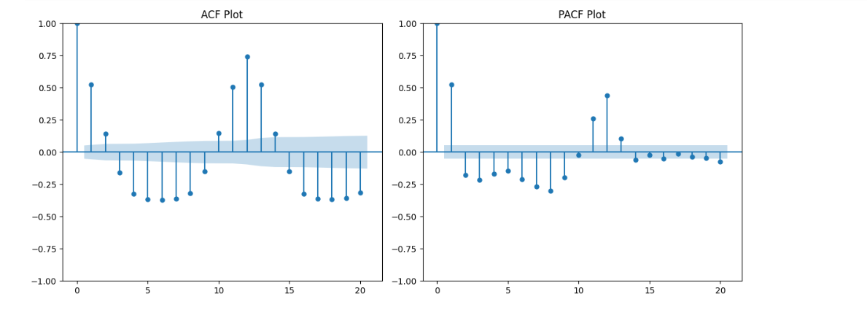
ADF test confirms stationarity
Series | ADF Statistic | p-value | Verdict
Raw rainfall | -5.59 | 1.32 × 10⁻⁶ | Stationary
p-values are far below 0.05 → series is stationary in level form. Then SARIMA Model is applied.

Slide 14
Feature Engineering & Data Pipeline
1
Wide → Long Format Convert 1 row/year into 1,452 monthly records with a proper datetime index.
2
Cyclical Month Encoding Encode month as sin/cos so the model understands Jan and Dec are adjacent.
3
Lag Features Previous 1, 2, 3, and 12 months of rainfall as input features.
4
Rolling Statistics 3, 6, and 12-month rolling mean and standard deviation.
5
Train / Test Split Last 24 months (2020–2021) held out as test set — no data leakage.

Slide 15
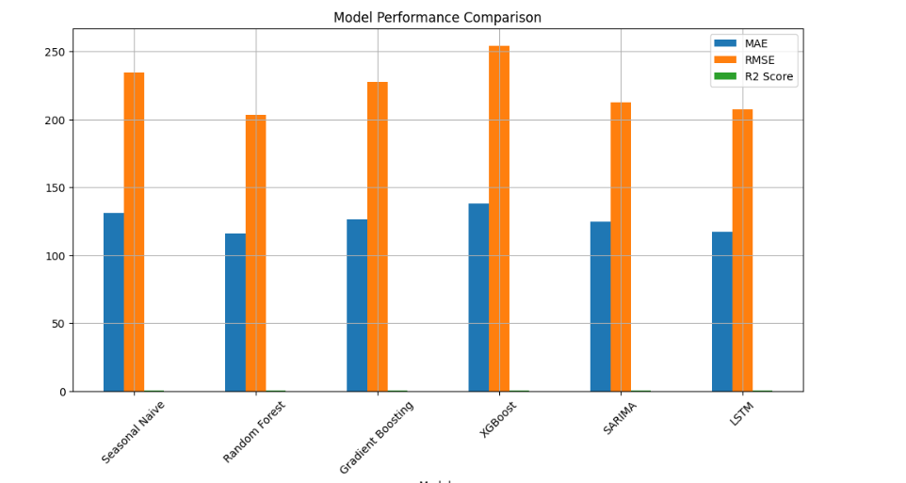
MODEL COMPARISON
6 Models Evaluated — Random Forest Wins
Model | MAE | RMSE | R²
Seasonal Naive | 130.946487 | 234.820023 | 0.655831
🏆Random Forest | 116.098382 | 203.635031 | 0.741175
Gradient Boosting | 126.355210 | 227.848186 | 0.675964
XGBOOST | 138.293173 | 254.257754 | 0.596494
SARIMA | 124.781893 | 212.711007 | 0.717589
LSTM | 117.510478 | 207.114030 | 0.595140
Random Forest outperforms all models with the lowest RMSE (203.63 mm) and highest R² (0.741). It captures non-linear seasonal patterns without requiring feature scaling.

Slide 16
Random Forest Hyperparameter Tuning
Applied Randomized Search Cross-Validation to optimize Random Forest model performance.
Tested multiple parameter combinations including number of trees, tree depth, split criteria, and feature selection strategy.
Best parameters identified:
n_estimators: 100
max_depth: 30
min_samples_split: 5
min_samples_leaf: 4
max_features: sqrt
Hyperparameter tuning improved model generalization and forecasting accuracy.
Final tuned model achieved:
MAE: 113.01
RMSE: 199.17
R² Score: 0.752

Slide 17
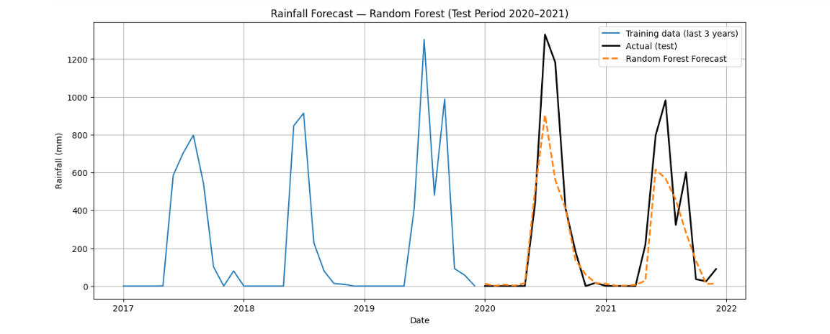
Forecast vs Actual Plot
Random Forest predictions closely follow actual rainfall patterns, with some underestimation during extreme rainfall peaks.

Slide 18
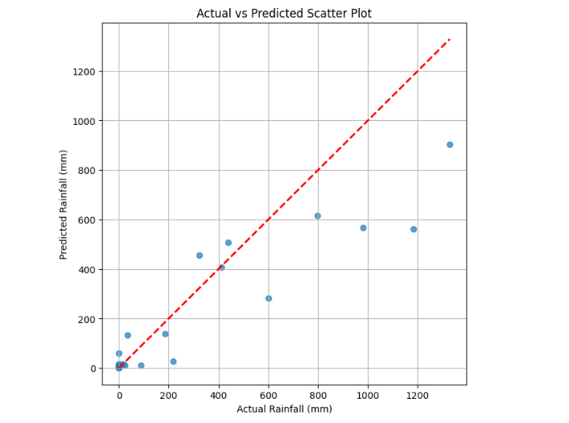
Actual vs Predicted Scatter
The model predicts low to moderate rainfall fairly well, but it struggles to fully capture extremely heavy rainfall events.

Slide 19
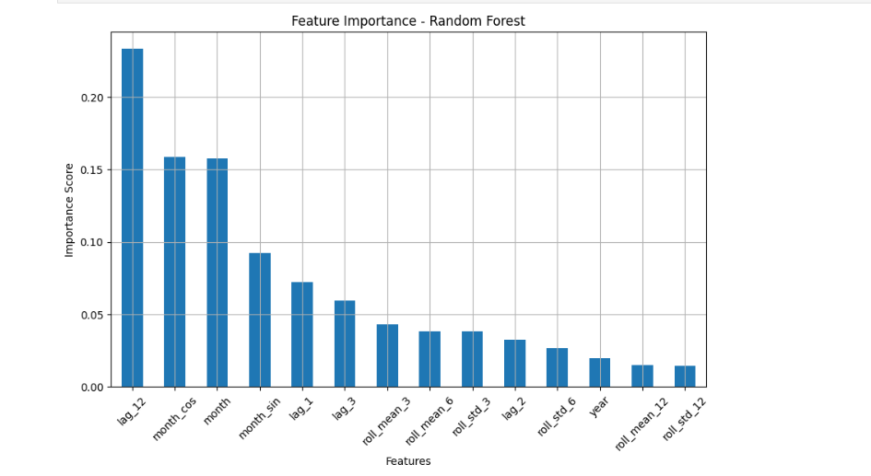
What the Random Forest Learned
Key Insights:
The 12-month lag captures 'same month last year’ is the most important feature — confirming that seasonal timing drives rainfall.
Cyclical month encoding (sin/cos) strongly influences predictions— strong seasonal memory in Mumbai's monsoon pattern.
Short-term rainfall trends improve forecasting accuracy.

Slide 20
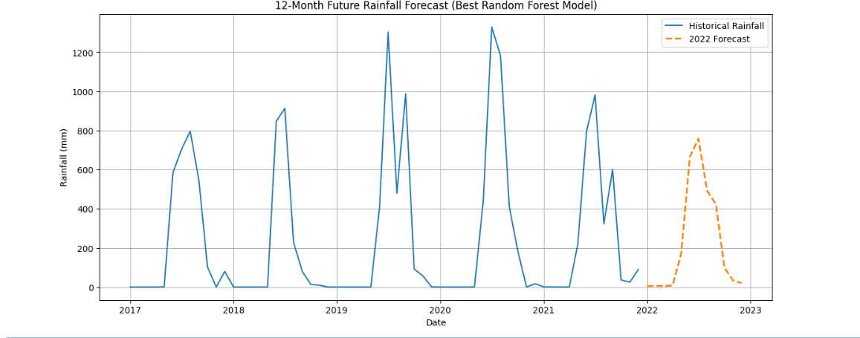
Forecasted Monthly Rainfall — 2022
The final model was retrained on the full dataset (1901–2021) and used to iteratively forecast each month of 2022.

Slide 21
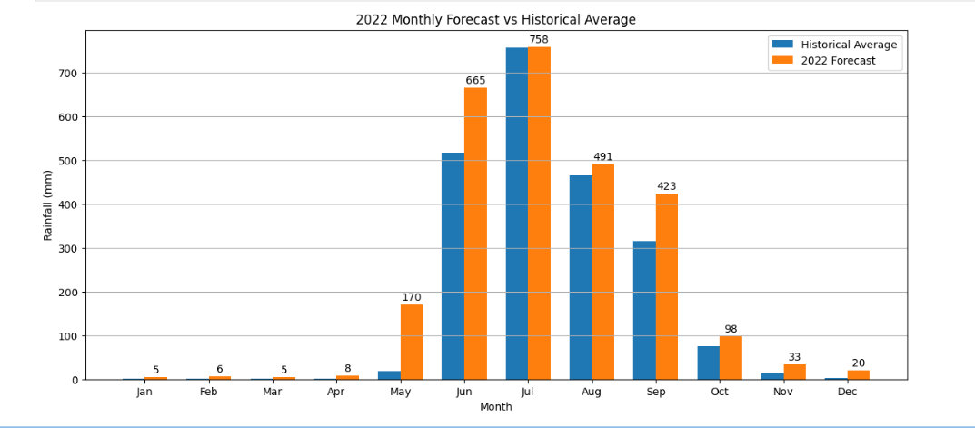
Forecasted Monthly Rainfall — 2022
Summary
Peak Month
July
Driest Month
January
Historical Mean
2168mm

Slide 22
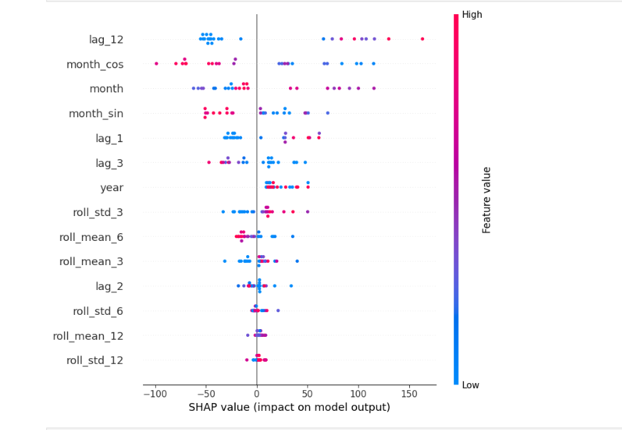
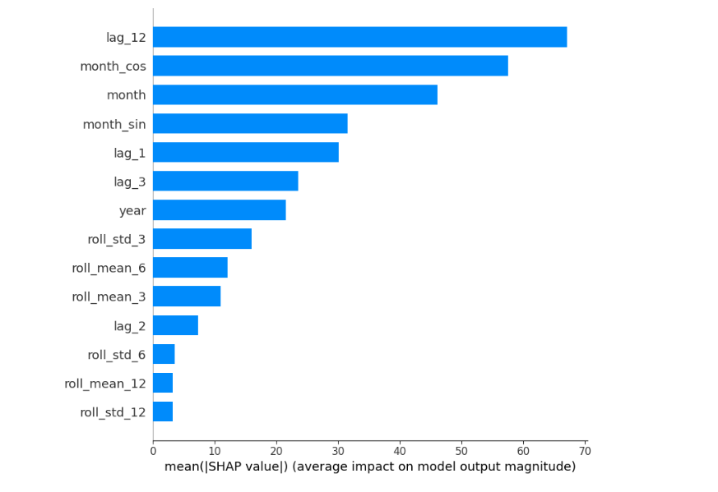
SHAP Analysis

Slide 23
Strategic Actions for Water Resource Management
Pre-Monsoon Jan – May
Reduce reservoir withdrawals — maximise storage capacity before June. Schedule pipeline & dam maintenance (low rainfall window). Activate water conservation protocols.
Monsoon Peak Jun – Sep
Pre-position pumping capacity before June 1st. Inspect overflow spillways and flood management infrastructure. Monitor dam levels weekly during July–August peak.
Post-Monsoon Oct –Dec
Optimise carry-over storage for 2023 dry season buffer. Plan distribution strategy based on reservoir levels. Review forecast accuracy vs actuals — retrain model.

Slide 24
Limitations
The model is trained only on historical rainfall data and does not include external weather factors such as temperature, humidity, or atmospheric conditions.
Extreme rainfall events remain challenging to predict accurately, with some underestimation in peak rainfall periods.
Forecasting performance may be affected by long-term climate pattern changes not fully captured in historical trends.
The model is specific to Mumbai rainfall data and may not generalize directly to other regions.
Future Enhancements
Incorporate additional weather and climate variables to improve forecasting accuracy.
Explore advanced deep learning architectures for better capture of complex rainfall patterns.
Extend forecasting to longer prediction horizons with regular model retraining.
Deploy the model as an interactive forecasting dashboard for real-time decision support.

Slide 25
Conclusion
Random Forest achieved RMSE 203.63 mm and R² 0.741 — best of 6 models
2022 forecast: above-average monsoon season predicted
Lag features & cyclical month encoding drive model accuracy
Actionable recommendations for reservoir, maintenance, and drought prep

Slide 26
THANK YOU

